Slide 1
Enhanced Scanning Tool
Under guidance of
Ms.Abirami A,
Department of IT,
Assistant professor,
BIT,
Sathy.
Student 1 :SAKTHI S M(202IT208)
Student 2 : THENISHA S(202IT252)

Slide 2
Abstract
As data shared in websites can be tracked by hackers .so to test our website vulnerability using some hacking tools which can also be used by normal people. A tool can perform scanning on websites for their vulnerability identification. It help us to find the week website.

Slide 3
Problem Statement Addressed
In the real world as opposed to the cyber world an attack is often preceded by information gathering. The emergence of ecommerce application and social networks, organization across the world generate the large amount of daily data. Information security is the most important issue in guaranteeing safe transmission of data through the web. As of now all of us are moving towards the digital information age, we need a secured network. As more and more users use the internet which attracts a lot of cyber-attacks. It required a computer and network security. Hubs which is very pernicious makes an issue in the system.

Slide 4
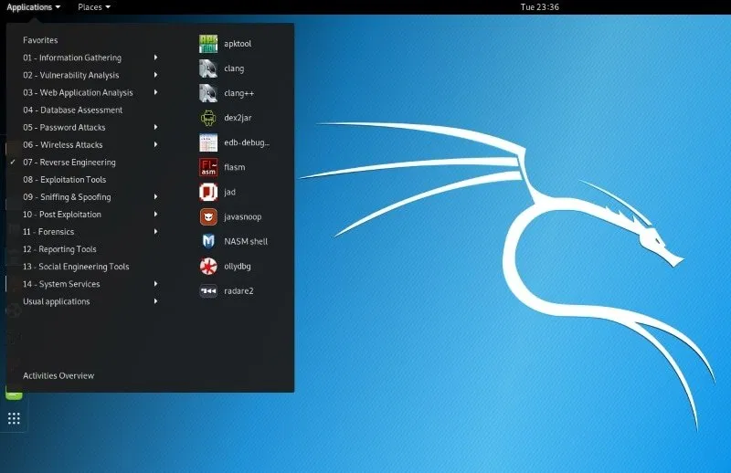
Existing Solution to the Problem Addressed
In kali linux many scanning tools are available but can’t be accessed by normal people as it has comments to execute Tools.

Slide 5
Proposed Solution to the Problem Addressed
We have integrated the tools for scanning and bruteforce scanning on mail, facebook, instragram into single tool which is easy to be accessed by normal people. It may include options like :
Scanning open ports
Scan your network
Scan the most popular ports
Scan TCP or UDP protocols
Scan a firewall for MAC address spoofing

Slide 6
Scan a single port
Default script scan
Scan filtered ports
Scan list of hosts from a file
Scan an IP address range
And many more options are available in this tool.

Slide 7
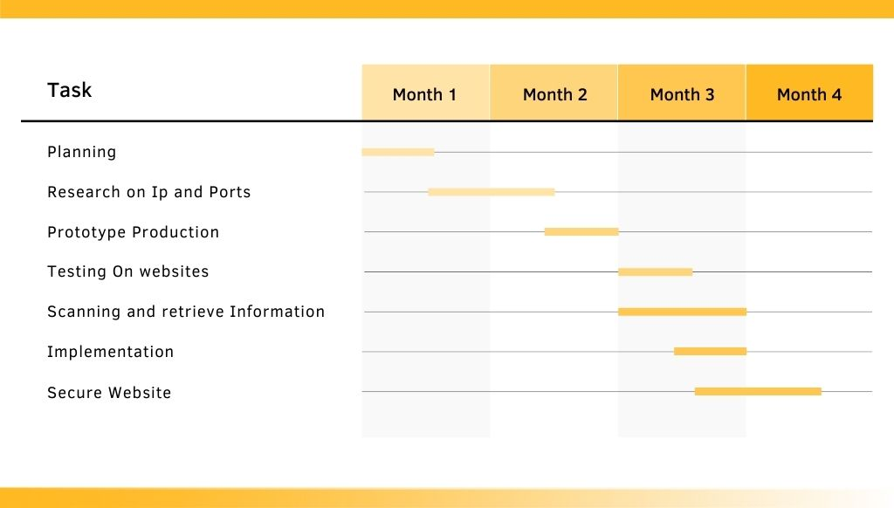
Project Work Plan
Role Assistant : Lab Incharge
Implementation:
1.Input – Website link.
2.Bash and python code which help to access the website and scan.
3.Output- Ip Information, Ports available, Vulnerability information as record.

Slide 8
Block Diagram
Collection and classification of tools
Resource Input
Scan& Diagnosis
Vulnerability effect analysis
Reject or accept

Slide 9
Flow Chart
Scanning options can be choose by user
Website link
Scanning tool
Vulnerability
Secured
Unsecured
Ip and Port Information of Website

Slide 10
Effective utilization of the Modern Tool & Cloud
As kali linux is a choosen platform for integrating scanning tools.It can’t be easly vulnerable to hackers. Kali Linux is mainly used for advanced Penetration Testing and Security Auditing. Kali contains several hundred tools which are geared towards various information security tasks, such as Penetration Testing, Security research, Computer Forensics and Reverse Engineering.

Slide 11
Technology stack & use case
Scan vulnerability on website
Web application
OS: Kali linx
Standard Code Editor
Technology stack
Banking website
Public Data Collection places
Usecase

Slide 12
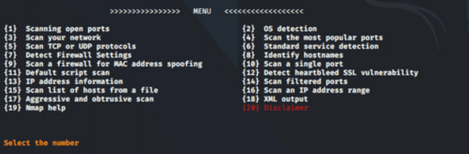
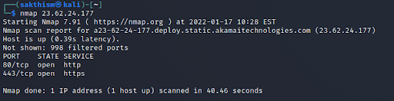
Prototype & Sample Output
Scanning the website and check by bruteforce

Slide 13
Analysis of Results & Discussions
Showstopper:
1.It can’t be executed on other operating system like windows,ubuntu.
2.It can be misused by hackers.
Advantage:
1.Even common people can scan their own website.
2.Avoid getting into vulnerable websites.

Slide 14
Cost Benefit Analysis (List of Components / Service Used)
It’s Software no need components.
S.No | Component Name | Specification (IC number or Range or Value) | Unit Cost | Total Cost
- | - | - | - | -
- | - | - | - | -
- | - | - | - | -
- | - | - | - | -
- | - | - | - | -

Slide 15
References
https://securitytrails.com/blog/kali-linux-tools
Kali linux-Information Gathering Tools

